Slide 1

VOCABULARY IMPROVING DAY 03
Prepared By: Nimra Noor
Date:04-May-2025

Slide 2
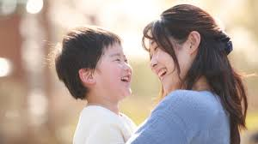
1. Abiding (adj.)
Meaning: Lasting, permanent, unchanging
Example: "Her abiding love comforts him."

Slide 3
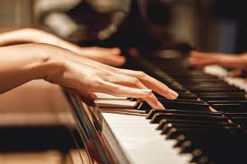
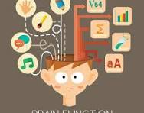
2. Ability (n.)
Meaning: Skill/Talent
Example: "She has the ability to play the piano beautifully."
Meaning: Capacity
Example: "His mental abilities are impressive."

Slide 4
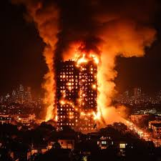

3. Ablaze (adj.)
Meaning: On fire
Example: "The building was ablaze."
Meaning: Brightly lit
Example: "The sky was ablaze with stars."

Slide 5
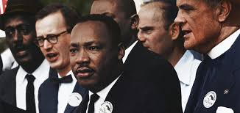
4. Able (adj.)
Meaning: Capable/Skilled:
Example: “He is an able leader."

Slide 6
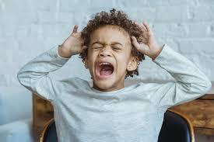
5. Abnormal (adj.)
Meaning: Unusual/Strange
Example: "His behavior was abnormal.”

